Slide 1

CSE 4800: Thesis
Binary Function Clone Detection
Using MBA Simplification
Presented By -
Tasnimul Hasnat (190041113)
Sumit Alam Khan (190041207)
Md Abdullahil Kafi (190041224)
Supervised By -
Dr. Md Moniruzzaman,
Assistant Professor, IUT
Imtiaj Ahmed Chowdhury,
Lecturer, IUT

Slide 2
Table of Contents
1
2
3
Relevant Concepts
Problem Statement
Methodology
4
5
Experimental Results
Conclusion

Slide 3
Function Cloning
Function cloning is slightly modifying a function so that the changes do not affect the function's behavior.
Function cloning can be broadly categorized into two types:
Optimization
Obfuscation

Slide 4
Function Cloning (Optimization)
func1:
mov -20[rbp], edi
mov -24[rbp], esi
mov -8[rbp], 10
mov eax, -8[rbp]
xor eax, -20[rbp]
sub eax, -24[rbp]
mov -4[rbp], eax
mov eax, -24[rbp]
imul eax, -4[rbp]
mov edx, eax
mov eax, -20[rbp]
add eax, edx
ret
int func1(int a, int b){
int x;
int y;
x = 10;
y = (x ^ a) - b;
return b * y + a;
}
func1:
mov eax, edi
xor eax, 10
sub eax, esi
imul esi, eax
lea eax, [rsi+rdi]
ret
No Optimization
Source Function
O1 Optimization

Slide 5
Function Cloning (Obfuscation)
int func1(int a, int b) {
int x;
int y;
x = 10;
y = (((x ^ a) & ~b) << 1)
- ((x ^ a) ^ b);
return ((b * y - ~a) -1);
}
func1:
mov edx, edi
xor edx, 10
mov eax, esi
not eax
and eax, edx
add eax, eax
xor edx, esi
sub eax, edx
imul esi, eax
not edi
sub esi, edi
lea eax, -1[rsi]
ret
func1:
mov eax, edi
xor eax, 10
sub eax, esi
imul esi, eax
lea eax, [rsi+rdi]
ret
~
~
Equivalent Obfuscated Function
Optimized and obfuscated
O1 Optimized Function

Slide 6
Control Flow Graph (CFG)
int f() {
...
y = read();
z = y * 2;
if (z == 12) {
return;
} else {
printf("OK");
}
}
start
y = read()
z = y*2
z == 12
Represents flow of execution
Nodes → Blocks of code
Edges → Control flow
return
end
printf(“OK”)

Slide 7
Symbolic Execution
Explores the CFG of a function with symbolic values rather than concrete values.
start
int f() {
...
y = read();
z = y * 2;
if (z == 12) {
return;
} else {
printf("OK");
}
}
y = λ
y = read()
Expressions
z = λ*2
z = y*2
Constraints
λ * 2 == 12
z == 12
λ * 2 != 12
return
end
printf(“OK”)

Slide 8
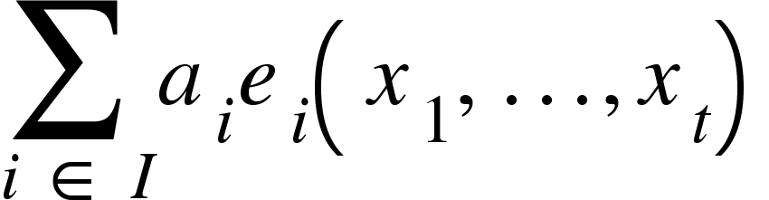
Mixed Boolean Arithmetic (MBA)
MBA Expression:
Expression containing both traditional arithmetic operations (+, −, ×, . . .) and bitwise boolean operators (∧, ∨, ¬, ⊕, . . .)
where,
x_{t} → variables a_{i} → constant coefficient
e_{i}(x₁ … x_{t}) → bitwise expressions
Figure: Formal Definition of MBA Expression¹
[1] MBA-Blast: Unveiling and Simplifying Mixed Boolean-Arithmetic Obfuscation in the Proceedings of USENIX Security Symposium, 2021.

Slide 9
Mixed Boolean Arithmetic (MBA)
MBA Expression:
A sequence of assembly instructions can be represented as MBA expressions.
inc eax
eax = eax + 1
and eax, ebx
eax = (eax + 1) & ebx
and eax, ecx
eax = ((eax + 1) & ebx) & ecx
Figure: Symbolic Execution on Assembly Instructions representing MBA Expressions.

Slide 10
Satisfiability Solver
Operates by taking a logical expression as input.
Determines whether there exists an assignment to the variables that makes the logical expression satisfiable or not.
Can simplify logical expressions while determining satisfiability.
Can also show equivalence between different MBA expressions.

Slide 11
Limitations of existing literature
Current solutions are mostly semantic based Machine Learning algorithms. They,
Incur unnecessary overhead.
Work only for small and medium sized binaries.
Doesn’t work well against obfuscation techniques.
Need to train the model from the beginning when new data is introduced.

Slide 12
Problem Statement
Given two binary files identify binary similarity through function clone detection using MBA simplification

Slide 13
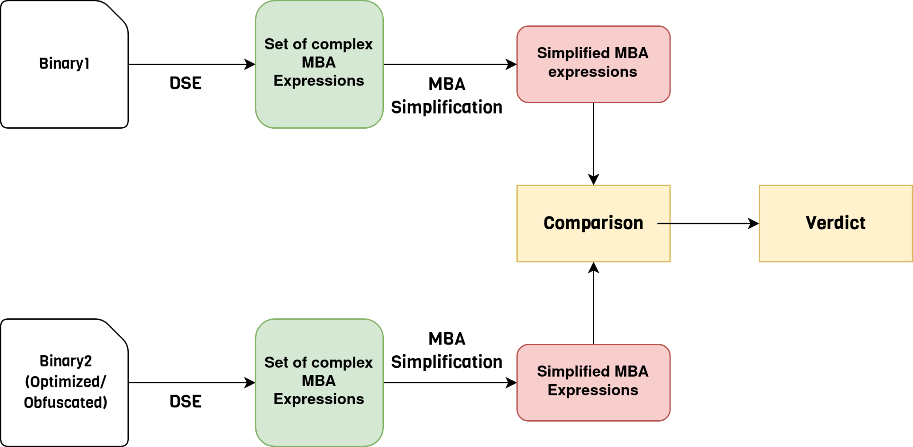
High Level Overview

Slide 14
Methodology
Binary
Function
Path
Expressions
Constraints
Determining Function Boundary
Function
Function
Function
Path
Path
Path
Expressions
Constraints
Expressions
Constraints
Expressions
Constraints
Path Extraction
Path
Expressions
Expressions
Constraints
Symbolic Expr & Constr Extraction
Constraints

Slide 15
Methodology
Function A
Function B
Function Matching
Path 1
Path 2
Expr
Constr
Expr
Constr
#
Expr
Path
Constr
Expr
Path
Constr
Path Matching
Symbolic Expr & Constr Matching
Expr
Expr
Score Matrix
Constr
Constr
Score Matrix
#
#
#
Expr
Constr
#
#
#
similarity
#
#
#
similarity
Expr
Constr
#
#
#
#
#
#
Constraint and Expression Matching
#
#
#

Slide 16
Constraint and Expression Matching
Longest Common Subsequence (LCS) Based Approach
Abstract Syntax Tree (AST) Isomorphism Based Approach
Satisfiability Solver Based Approach
Angr Z3² Backend
[2] Z3: An Efficient SMT Solver in the Proceedings of International Conference on Tools and Algorithms for the
Construction and Analysis of Systems, 2008.

Slide 17
Experimental Results

Slide 18
Experimental Setup
Collected source codes from the Coreutils library.
Compiled binaries using both gcc and clang compiler.
Compiled the binaries with multiple optimization levels (Og, O1, O3) for each compilers.
Collected obfuscated binaries from various sources e.g custom codes, CTF challenges etc.
The experiments were ran on a computer with 128GB RAM and Intel core i9 12900K cpu.

Slide 19
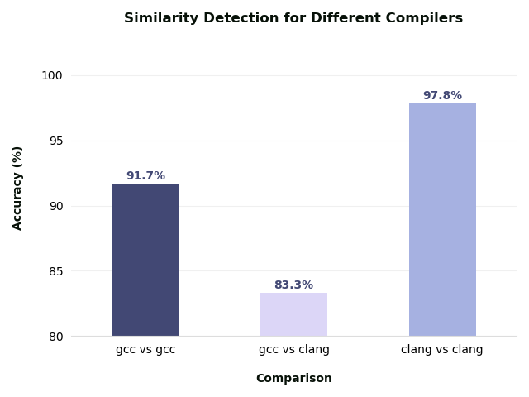
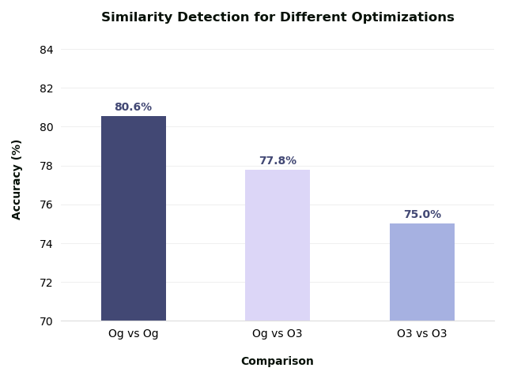
Similarity Detection

Slide 20
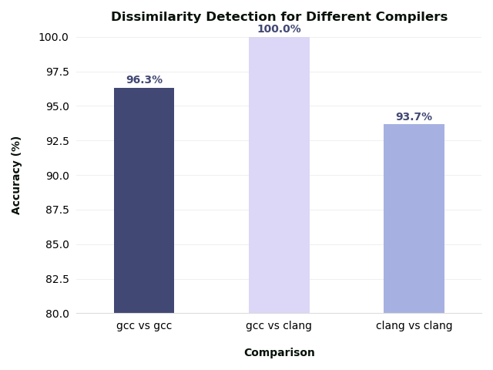
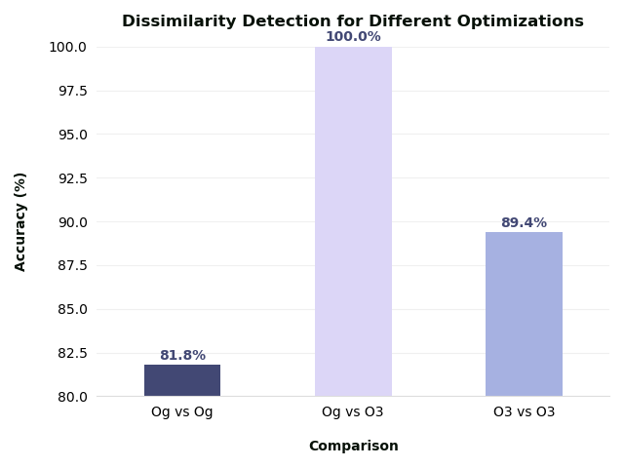
Dissimilarity Detection

Slide 21
Comparison with Existing Works
BinDiff | Graphlet | GeneDiff | LSH-S | Our Approach
0.938 | 0.695 | 0.961 | 0.86 | 0.8787
BinDiff, GeneDiff and LSH-S has better accuracy but due to being machine learning based incurs huge overhead.
Graphlet is a graph based approach but it is quite old. Our algorithm outperforms it significantly.

Slide 22
Conclusion
Managed to identify binary similarities with an overall accuracy of 87.87%.
Identified but not solve for conditional branching with side effects, which is a scope for future works.
Decompiling 03 optimized binaries is very error-prone reducing accuracy.
Most of the time was spent to prove satisfiability between expressions. In future better SAT solvers can reduce operation time.

Slide 23
Thank You

Slide 24
Challenges (WIP)
Extracting MBA expressions from branches and loops.
Comparing equivalence of set of simplified expressions
Choosing the appropriate form of verdict (binary vs similarity metrics).

Slide 25
Methodology
Binary
Function
Path
Expressions
Constraints
Function
Function
Function
Path
Path
Path
Expressions
Constraints
Expressions
Constraints
Expressions
Constraints
Path
Expressions
Expressions
Constraints
Constraints

Slide 26
Methodology
Function A
Function B
Function Matching
Path 1
Path 2
Expr
Constr
Expr
Constr
#
Expr
Path
Constr
Expr
Path
Constr
Path Matching
Symbolic Expr & Constr Matching
Expr
Expr
Score Matrix
Constr
Constr
Score Matrix
#
#
#
Expr
Constr
#
#
#
similarity
#
#
#
similarity
Expr
Constr
#
#
#
#
#
#
Constraint and Expression Matching
#
#
#

Slide 27
Experimental Results
Accuracy: 83.33%
Accuracy: 91.67%
33.33% True Positive | 0% False Positive
50% True Negative | 20% False Negative
41.67% True Positive | 0% False Positive
50% True Negative | 8.33% False Negative
Figure: Confusion Matrix for only gcc (Og,O3) binaries
Figure: Confusion Matrix for only clang (Og,O3) binaries

Slide 28
Experimental Results
Accuracy: 87.56%
Accuracy: 84.97%
33.67% True Positive | 0% False Positive
50% True Negative | 16.67% False Negative
41.67% True Positive | 0% False Positive
50% True Negative | 8.33% False Negative
Figure: Confusion Matrix for Og optimization on both gcc and clang binaries
Figure: Confusion Matrix for O3 optimization on both gcc and clang binaries

Slide 29
Experimental Results (WIP)
Accuracy: 87.56%
33.67% True Positive | 0% False Positive
50% True Negative | 16.67% False Negative
Figure: Confusion Matrix for both compilers and optimization levels

Slide 30
Motivation
Copyright infringement is a serious issue in the software development industry.
Verification and code reuse identification in closed-source applications is significantly difficult.
Cybersecurity challenges increase as attackers modify the existing malwares to evade antivirus detection.
Existing methodologies for finding function clone is mostly Machine learning based which is difficult to scale.
A systematic method to find function clones from binary files could be scalable and easy to use.

Slide 31
Relevant Concepts

Slide 32
Reference
MBA-Blast: Unveiling and Simplifying Mixed Boolean-Arithmetic Obfuscation in the Proceedings of USENIX Security Symposium, 2021.
Binary Function Clone Search in the Presence of Code Obfuscation and Optimization over Multi-CPU Architectures ACM Asia Conference on Computer and Communications Security, July 2023
Qsynth- A Program Synthesis based Approach for Binary Code Deobfuscation NDSS Symposium Binary Analysis Research Workshop, 2020
Simplifying Mixed Boolean-Arithmetic Obfuscation by Program Synthesis and Term Rewriting ACM SIGSAC Conference on Computer and Communications Security, November 2023

Slide 33
Methodology (WIP)
Create testing dataset from the TREX binary database.
Determine the function boundaries and extract the functions.
Symbolically execute
Extraction of complex MBA expressions from obfuscated binary through dynamic symbolic execution.
Simplify the set of MBA expressions.
Check for equivalency between set of expressions using possible means e.g. SMT, fuzzing, program synthesis, graph isomorphism etc.

Slide 34
Existing Literature

Slide 35
Binary Function Clone Search in the Presence of Code Obfuscation and Optimization over Multi-CPU Architectures
ASIA CCS '23: Proceedings of the 2023 ACM Asia Conference on Computer and Communications Security, July 2023
Abdullah Qasem, Concordia University
Mourad Debbabi, Concordia University
Bernard Lebel, Thales Research and Technologies
Marthe Kassouf, Hydro-Québec Research Institute

Slide 36
Contribution
Developed and implemented BinFinder.
Identified resilient, interpretable binary function features against code optimizations and obfuscations on multi-CPU architectures.
Designed Siamese neural network architecture for training a model using proposed features to generate binary function embeddings.
Evaluated BinFinder in 3 scenarios- x86 with different optimization and obfuscation, multi-cpu architecture with and without optimization and obfuscation.

Slide 37
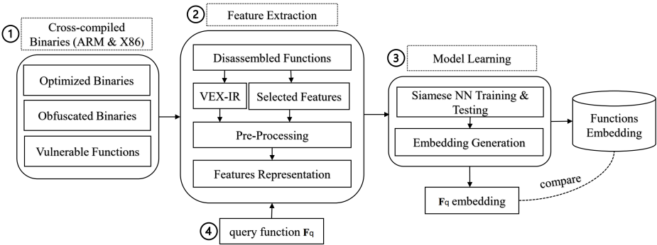
BinFinder - Methodology
[2] Binary Function Clone Search in the Presence of Code Obfuscation and Optimization over Multi-CPU Architectures ACM Asia Conference on Computer and Communications Security, July 2023

Slide 38
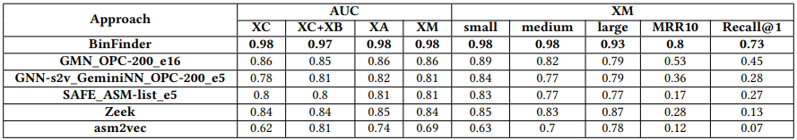
BinFinder - Evaluation
XA → Different Architecture, Same Obfuscation, Different Optimization.
XB → Same Architecture, Different Obfuscation.
XC → Different Architecture, Same Obfuscation, Same Optimization.
XM → Different Architecture, Different Obfuscation, Different Optimization.
[2] Binary Function Clone Search in the Presence of Code Obfuscation and Optimization over Multi-CPU Architectures ACM Asia Conference on Computer and Communications Security, July 2023

Slide 39
Qsynth- A Program Synthesis based Approach for Binary Code Deobfuscation
NDSS Symposium Binary Analysis Research Workshop, 2020
Robin David, Quarkslab
Luigi Coniglio, University of Trento
Mariano Ceccato, University of Verona

Slide 40
Contribution
Introduced a combination of dynamic symbolic execution, dataflow graph extraction, and program synthesis against obfuscation.
Proposed a black-box synthesis method based on offline enumerative search.
Utilized precomputed lookup tables for near constant-time expression synthesis.
Iteratively simplified complex obfuscated expressions.
Empirical validation through a comparison with the deobfuscation tool Syntia, demonstrating superior accuracy and speed (20x faster).

Slide 41
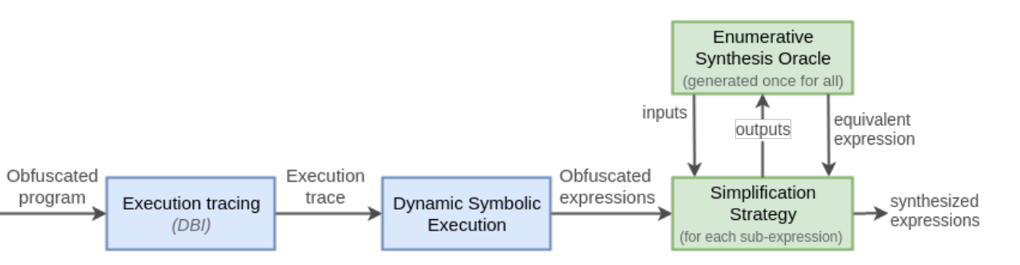
Qsynth - Methodology
Uses dynamic binary instrumentation (DBI) to trace paths in the binary.
From the traces, compute expressions at particular offsets using dynamic symbolic execution (DSE).
A synthesis oracle simplifies a complex equation.
[3] Qsynth- A Program Synthesis based Approach for Binary Code Deobfuscation NDSS Symposium Binary Analysis Research Workshop, 2020

Slide 42
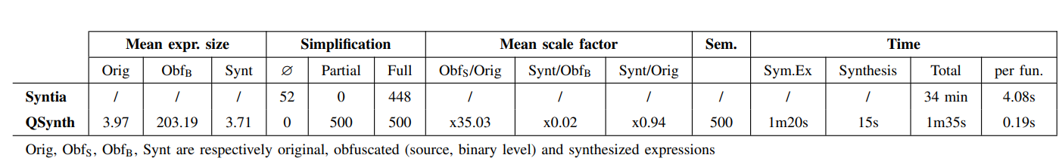
Qsynth - Evaluation
[3] Qsynth- A Program Synthesis based Approach for Binary Code Deobfuscation NDSS Symposium Binary Analysis Research Workshop, 2020

Slide 43
Simplifying Mixed Boolean-Arithmetic Obfuscation
by Program Synthesis and Term Rewriting
CCS '23: Proceedings of the 2023 ACM SIGSAC Conference on Computer and Communications Security, November 2023. Pages 2351–2365
Jaehyung ­Lee, Hanyang University, Ansan, Korea
Woosuk Lee, Hanyang University, Ansan, Korea

Slide 44
Contributions
Proposes a novel and versatile method called ProMBA for deobfuscating MBA expressions.
Combines program synthesis, term rewriting, and algebraic simplification methods.
Unlike existing techniques, ProMBA can deobfuscate a much broader class of MBA expressions.
Implemented the proposed method in an open source tool.
The experimental results show that ProMBA outperforms the state-of-the-art deobfuscation method, MBASolver by a large margin.

Slide 45
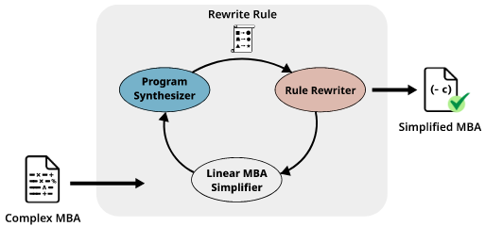
ProMBA - Methodology
Proposed method first simplifies linear MBA sub-expressions using an off-the-shelf deobfuscator.
Recursively simplifies non-linear sub-expressions by synthesizing simpler sub-expressions.
Applies the resulting rewrite rules to other sub-expressions until no further simplification is possible.
[4] Simplifying Mixed Boolean-Arithmetic Obfuscation by Program Synthesis and Term Rewriting ACM SIGSAC Conference on Computer and Communications Security, November 2023

Slide 46
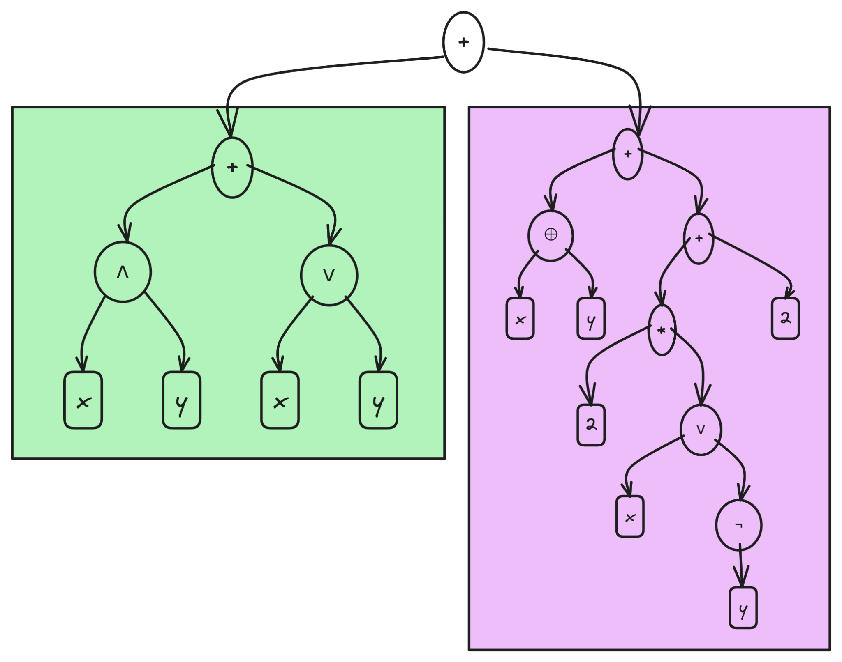
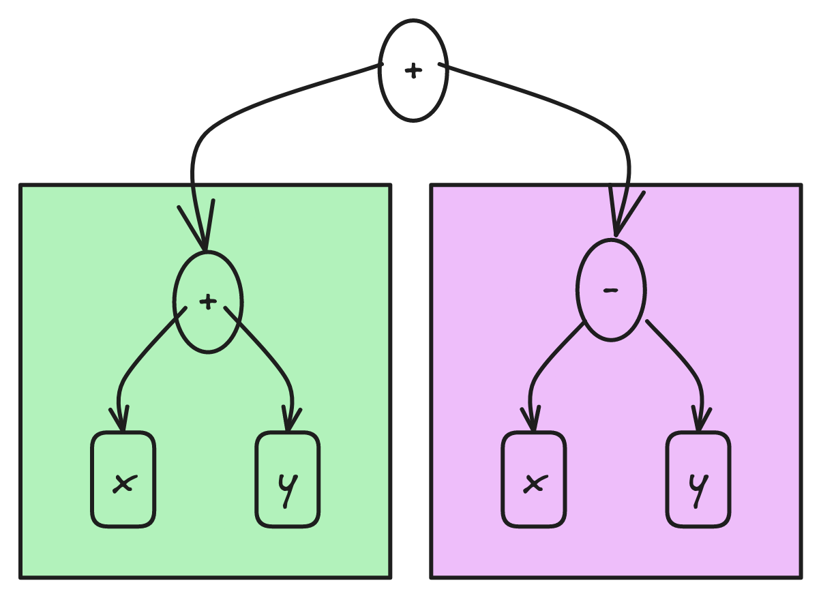
MBA Simplification
Known Rules:
x + y == (x ∧ y) + (x ∨ y)
x - y == x ⊕ y + 2 * (x ∨ ¬y) + 2
{(x ∧ y) + (x ∨ y)} + {x ⊕ y + 2 * (x ∨ ¬y) + 2}
x + y + x - y => 2x

Slide 47
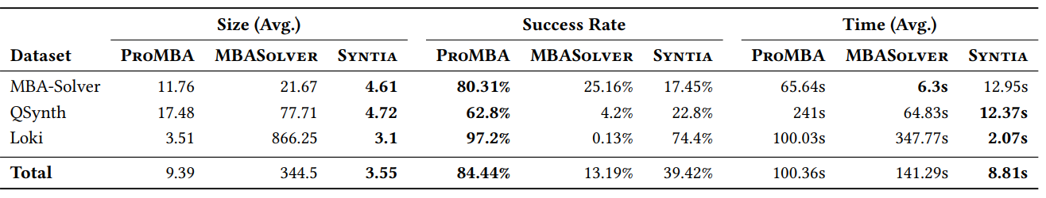
ProMBA - Evaluation
[4] Simplifying Mixed Boolean-Arithmetic Obfuscation by Program Synthesis and Term Rewriting ACM SIGSAC Conference on Computer and Communications Security, November 2023

